Slide 1


Healthcare Diagnostics: Use AI to analyze medical imaging for predicting the likelihood of certain conditions
Chest X-Ray Classification using Deep Learning (MobileNetV2 + Grad-CAM)
Presented By::
SHUBH PRADHAN 23030124195
VANSH MAHAJAN 23030124125
HEMANGI SINGLA 23030124171
SAMPADA BHARARA 23030124162

Slide 2



Introduction
This project is a Deep Learning-based Chest X-Ray Classification System
It classifies X-ray images into:
NORMAL
PNEUMONIA
Built using Transfer Learning with MobileNetV2
Designed to run on:
Local Windows System
Jenkins (CI/CD Environment)
Includes Grad-CAM for Explainable AI visualization

Slide 3





Manual diagnosis of chest X-rays is time-consuming
High chances of human error in medical imaging
Need for an automated AI-based classification system
Goal:
Fast
Accurate
Explainable Pneumonia Detection
Problem Statement

Slide 4





Objectives of the Project
Develop an optimized CNN model for X-ray classification
Achieve high accuracy on CPU systems
Use Transfer Learning for faster training
Implement Grad-CAM for model explainability
Make the system Jenkins-compatible

Slide 5
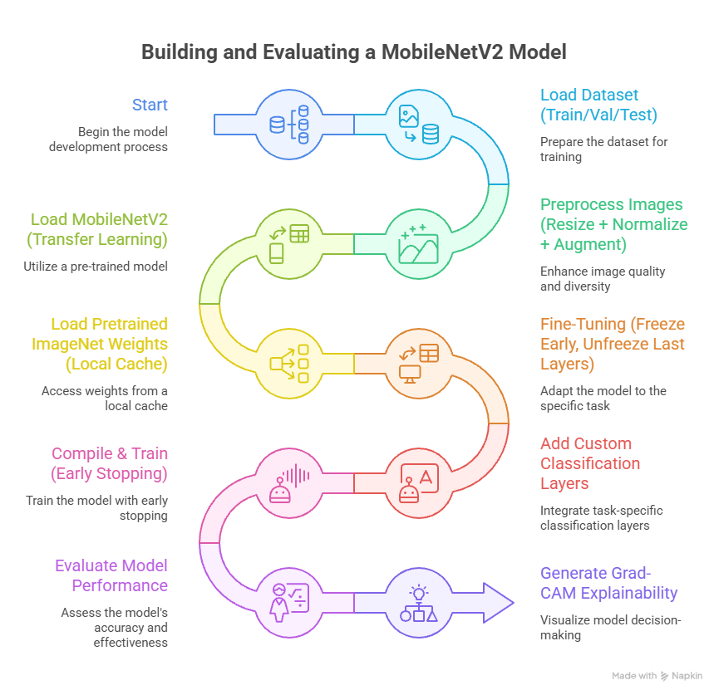
Built a deep learning model to classify chest X-ray images (NORMAL vs PNEUMONIA)
Used MobileNetV2 with transfer learning for high accuracy and fast training
Applied preprocessing and data augmentation to improve model performance
Fine-tuned the model by freezing early layers and training last layers
Evaluated using accuracy, confusion matrix, and classification report
Implemented Grad-CAM for explainable predictions
Designed to run on CPU and Jenkins (headless automated environment)

Slide 6



TECHNOLOGIES & TOOLS USED
OpenCV (cv2): For image processing and Grad-CAM visualization
NumPy: For numerical and array operations
Python: Main language for developing the project
TensorFlow & Keras: For building and training the deep learning model
Matplotlib: For plotting graphs and results
Scikit-learn: For evaluation metrics and performance analysis
Jenkins: For automated training and CI/CD execution
Windows OS: Local environment for training and testing the model

Slide 7
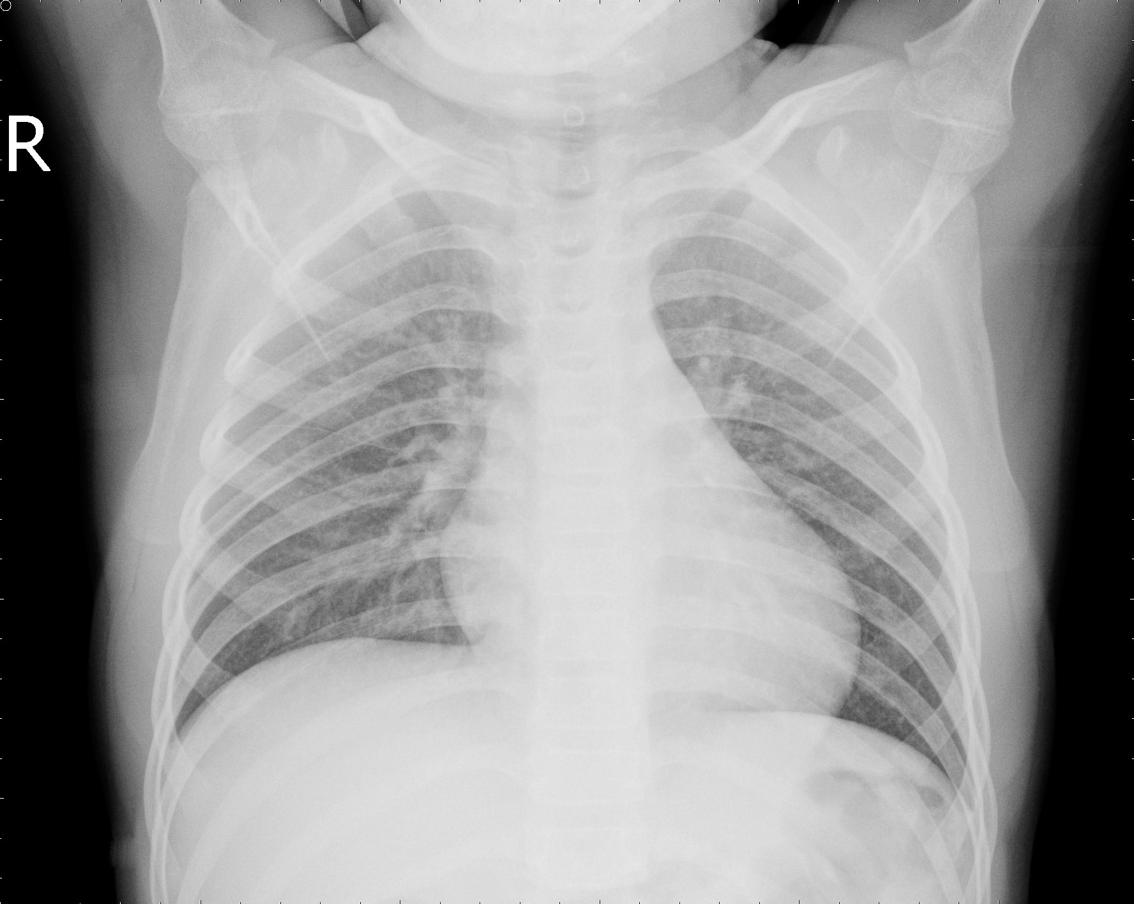
DATASET DESCRIPTION
Dataset: Chest X-Ray Images
Directory Structure:
Train Folder
Validation Folder
Test Folder
Classes:
NORMAL
PNEUMONIA
Images resized to: 160 × 160 pixels

Slide 8

Data Preprocessing & Augmentation
RESCALING PIXEL VALUES (1/255)
Image resizing (160×160)
Rotation (10°)
Zoom (0.1)
Horizontal flipping
Benefits:
Prevents overfitting
Improves model generalization
Enhances accuracy

Slide 9




MODEL ARCHITECTURE – MOBILENETV2
Pretrained CNN Architecture
Lightweight and efficient
Suitable for CPU training
Uses Depthwise Separable Convolutions
Faster than traditional CNN models
Transfer Learning is used for better performance

Slide 10




TRANSFER LEARNING STRATEGY
Loaded pretrained ImageNet weights manually (.h5)
Early Layers: Frozen (Generic features)
Last 40 Layers: Unfrozen (Fine-Tuning)
Helps model learn X-ray specific patterns
Reduces training time significantly

Slide 11

CUSTOM CLASSIFICATION HEAD
Layers added on top of base model:
GlobalAveragePooling2D
Dense Layer (ReLU – 128 neurons)
Dropout (0.4) → Prevent Overfitting
Final Dense Layer (Softmax)
Purpose:
Improve classification accuracy
Reduce overfitting

Slide 12





Model Compilation
Optimizer: Adam (Learning Rate = 0.0001)
Loss Function: Categorical Crossentropy
Evaluation Metric: Accuracy
Why Adam?
Fast convergence
Stable training
Good for deep learning models

Slide 13

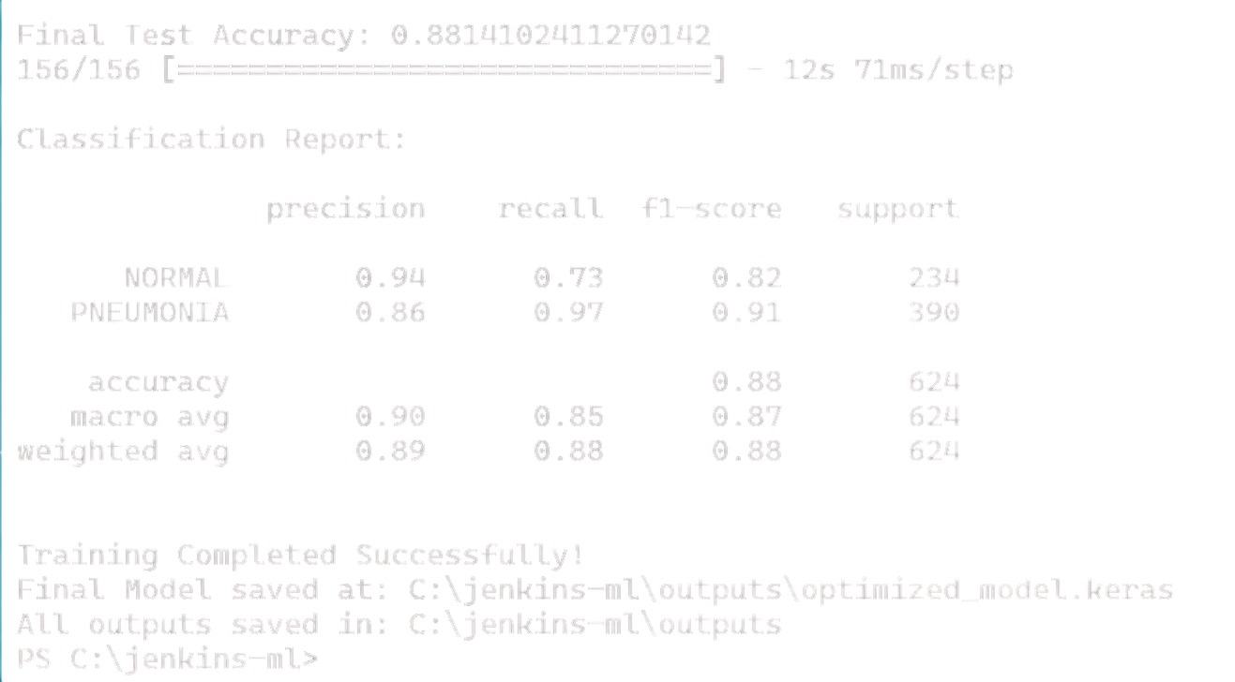
Model Evaluation Metrics
Test Accuracy
Classification Report
Confusion Matrix
Precision,
Recall,
F1-Score

Slide 14
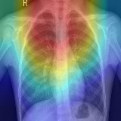
Grad-CAM
Grad-CAM = Gradient-weighted Class Activation Mapping
Functions:
Generates heatmaps on X-ray images
Shows important regions used for prediction
Improves model transparency in medical AI
Benefits:
Doctor-friendly visualization
Trustworthy AI decisions

Slide 15

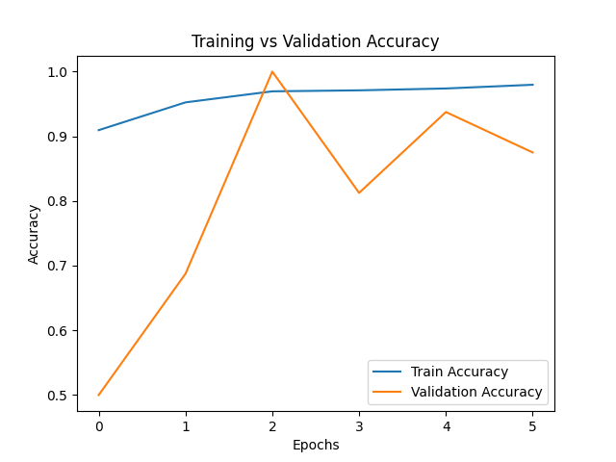

ACCURACY CURVE
Training accuracy increases steadily with each epoch
Validation accuracy improves rapidly after initial training
Minor fluctuations indicate slight overfitting or data variation
Both curves remain high, showing strong model performance
Overall, the model achieves good accuracy and generalization

Slide 16
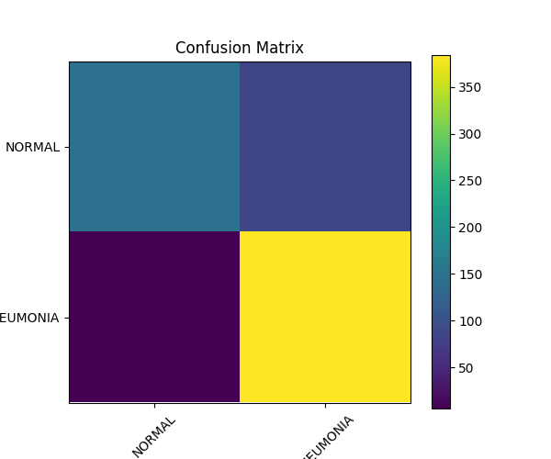
CONFUSION MATRIX
High correct predictions for both NORMAL and PNEUMONIA classes
Very few misclassifications between the two categories
Model accurately identifies pneumonia cases
Strong classification performance with good reliability
Indicates effective learning and good diagnostic capability

Slide 17
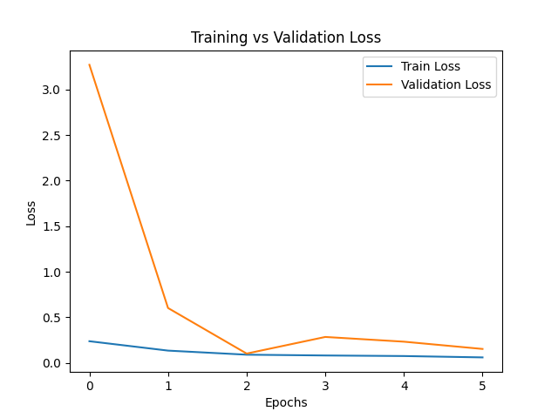
LOSS CURVE
Training loss decreases steadily over epochs
Validation loss drops sharply in early epochs
Slight increase at mid-epoch indicates minor overfitting
Both losses remain low, showing stable learning
Overall model converges well with good optimization

Slide 18

ADVANTAGES OF THE PROPOSED SYSTEM
APPLICATIONS
MEDICAL DIAGNOSIS SUPPORT SYSTEMS
Hospitals & Radiology Labs
AI Healthcare Research
Automated Pneumonia Detection
Smart Medical Imaging Systems
HIGH ACCURACY WITH TRANSFER LEARNING
CPU-friendly (Laptop compatible)
Jenkins automation support
Explainable AI using Grad-CAM
Faster training with Early Stopping

Slide 19


CONCLUSION
Successfully developed an optimized Chest X-Ray classification model
Used MobileNetV2 + Transfer Learning + Fine-Tuning
Achieved stable and efficient training on CPU
Implemented Grad-CAM for model explainability
Suitable for academic, research, and real-world healthcare applications
FUTURE SCOPE
Deploy as a Web Application
Integrate with Cloud (AWS/GCP/Azure)
Increase dataset size for better accuracy
Use advanced models (EfficientNet, ResNet)
Real-time X-ray analysis system

Slide 20









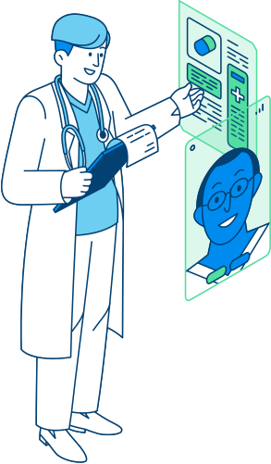

Thank You

